Slide 1
5 selfish reasons to work reproducibly
More publications, more grants, more awesome!

Slide 2
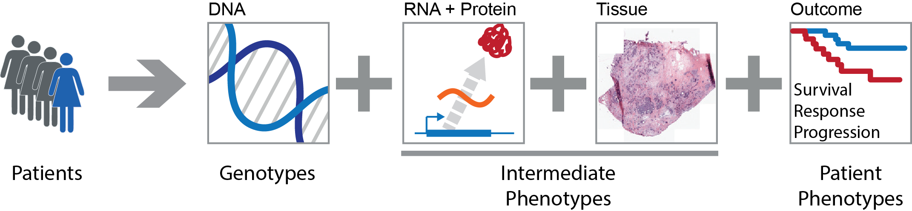
Systems Genetics of Cancer
Genetic variation
In people
In tumours
In clones
Phenotypic variation
Tumour subtypes
Aggressiveness
Survival

Slide 3
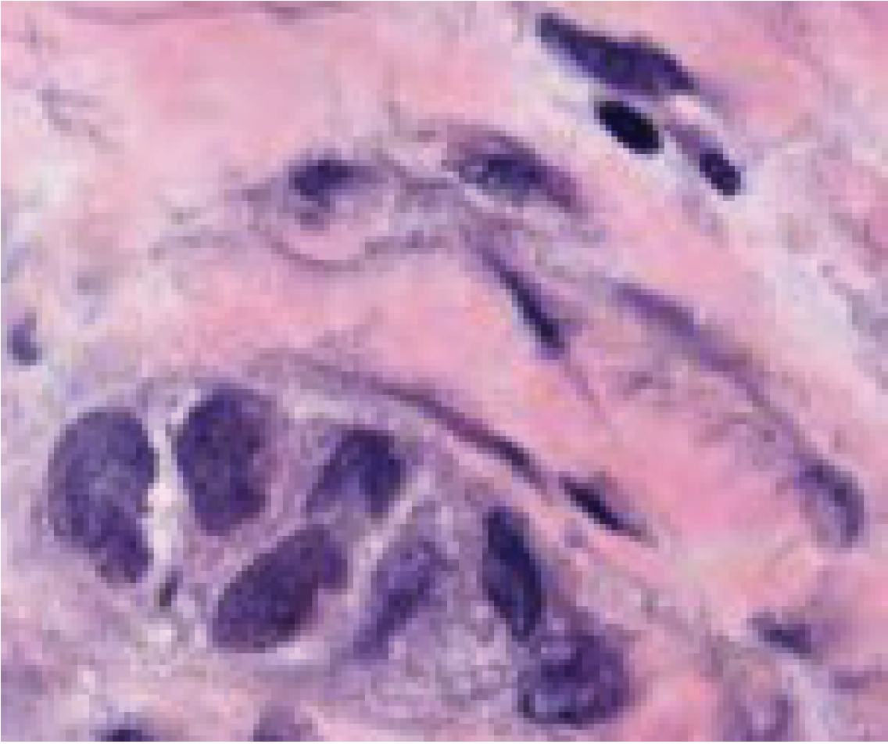

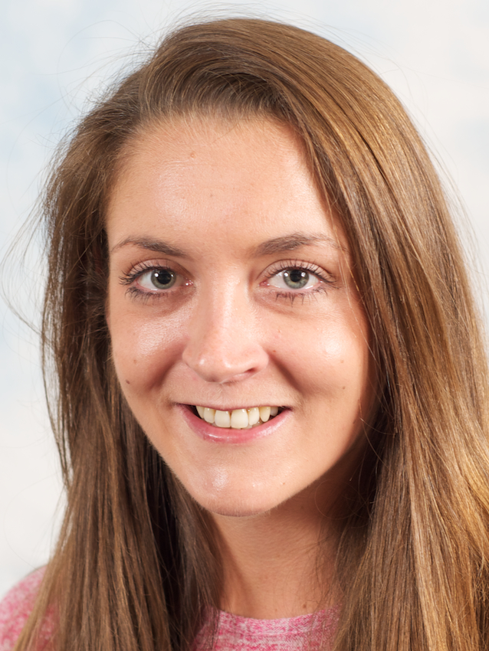
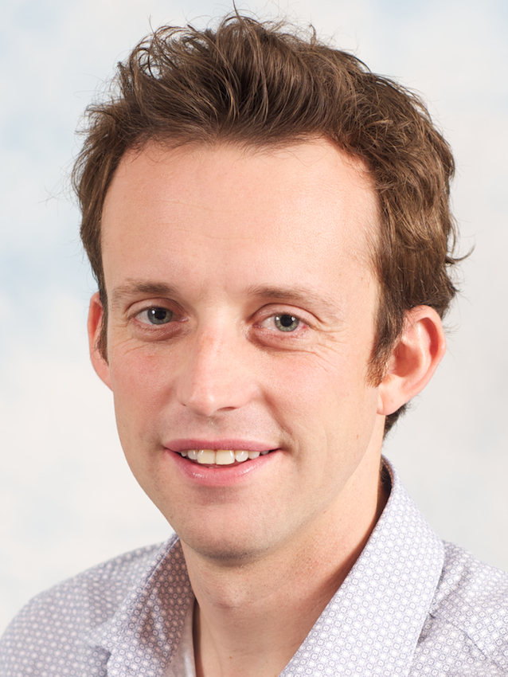
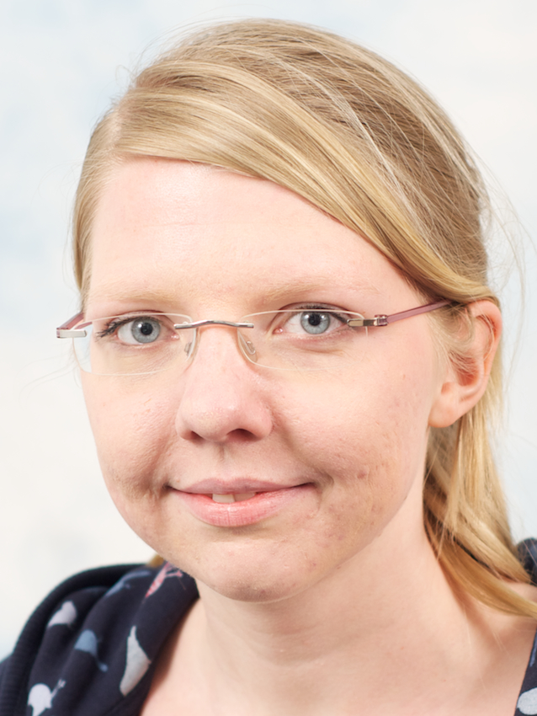

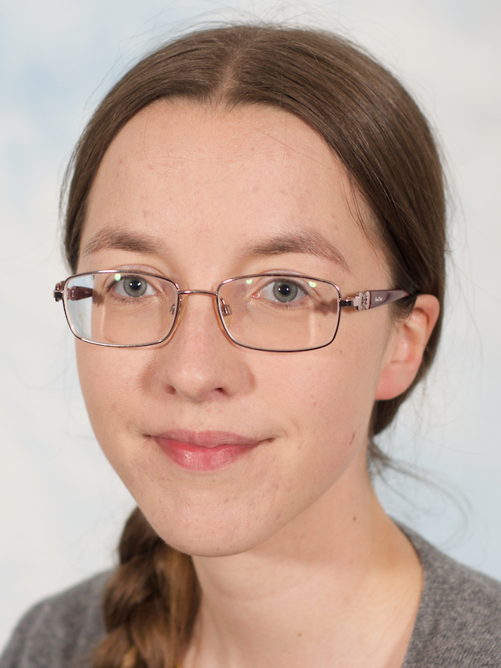
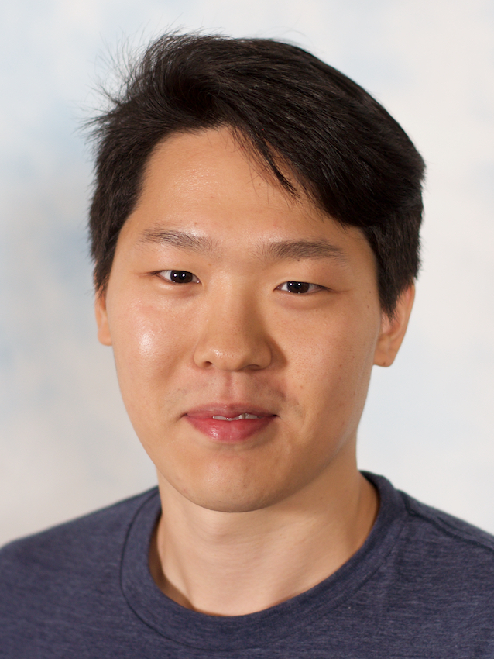

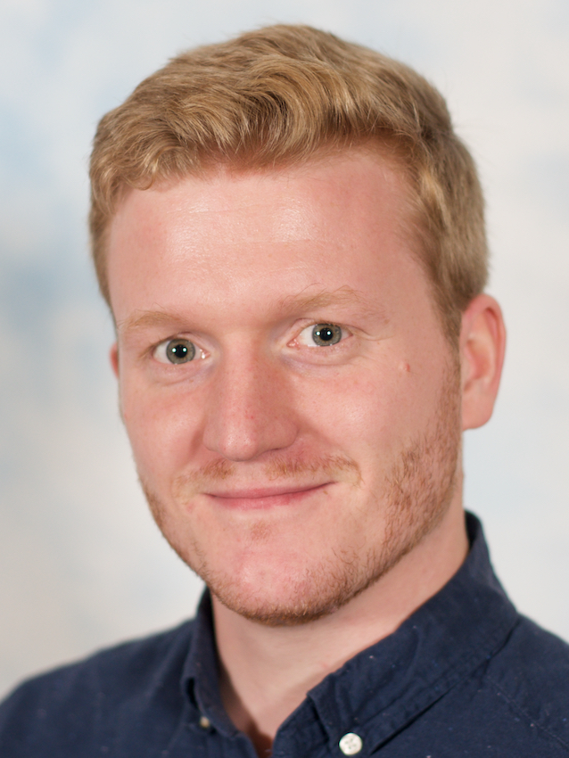
Cancer genome
Function
Cancer genome
Evolution
Cancer tissue
Context
Andy
Amanda
Geoff
Edith
Leon
Turid
Hyunjin
Federico
Ruben

Slide 4
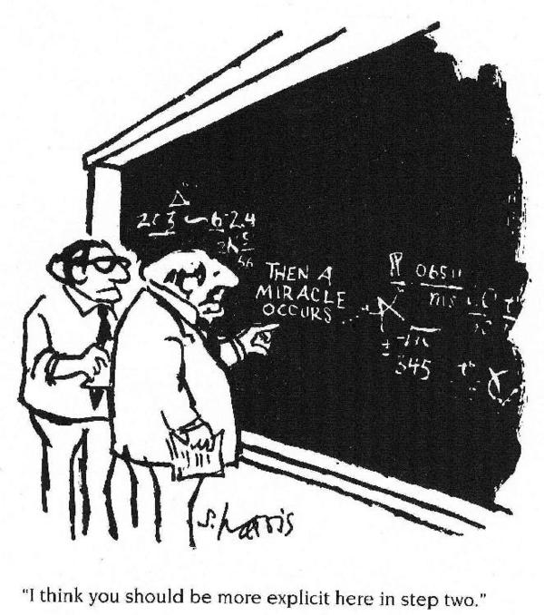
Science ≠ miracles

Slide 5
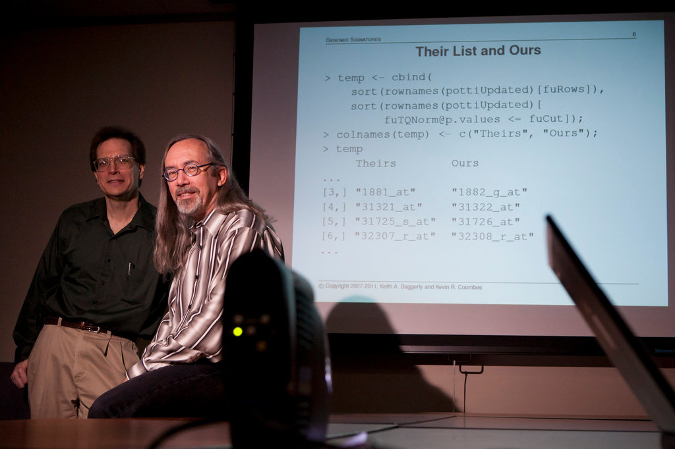
“How Bright Promise in Cancer Testing Fell Apart” New York Times 2011

Slide 6
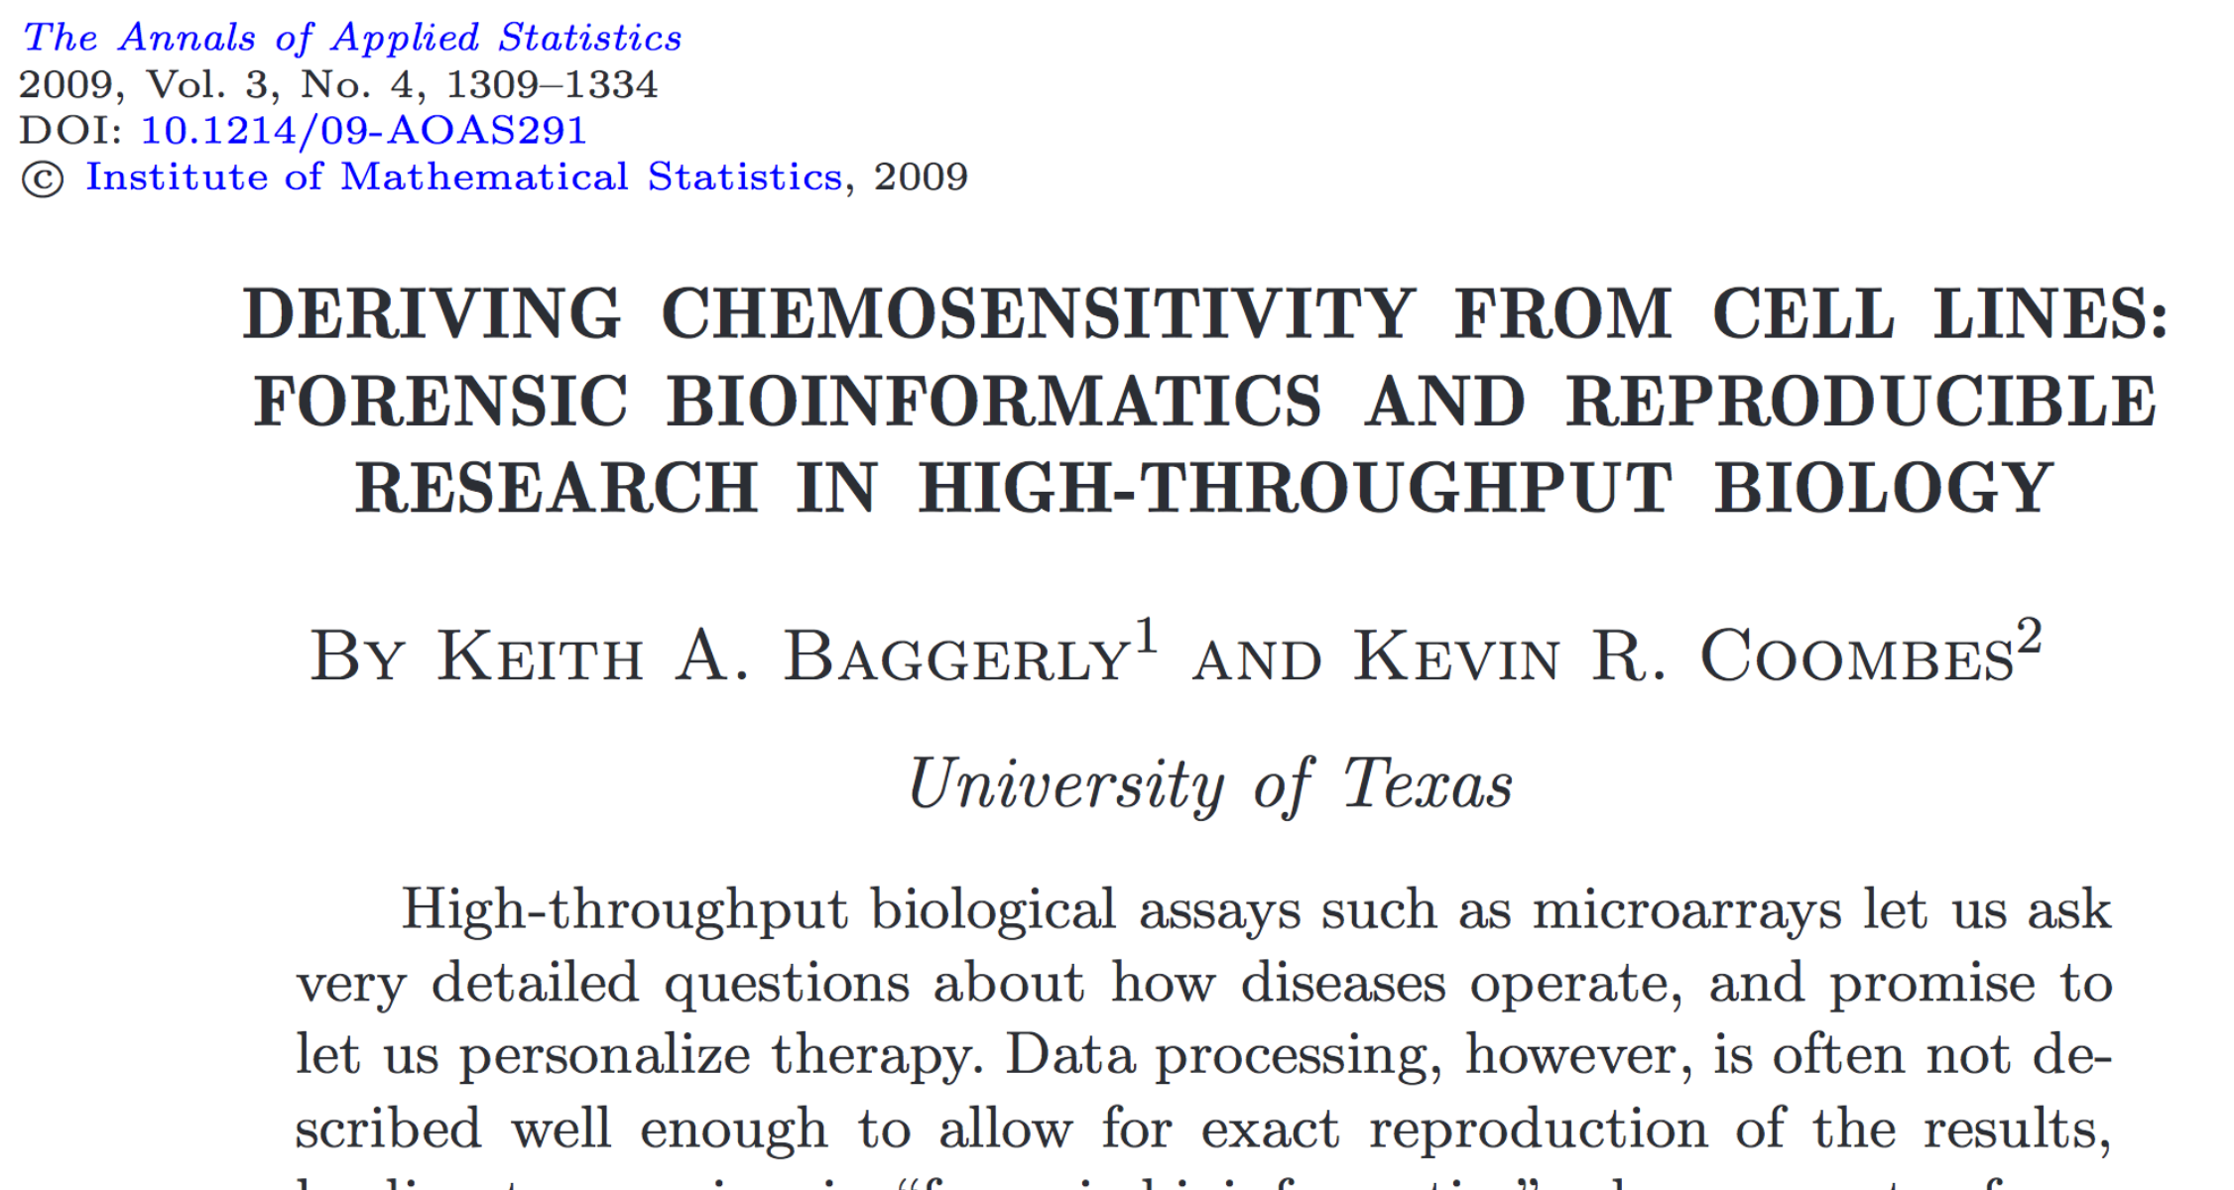

Slide 7
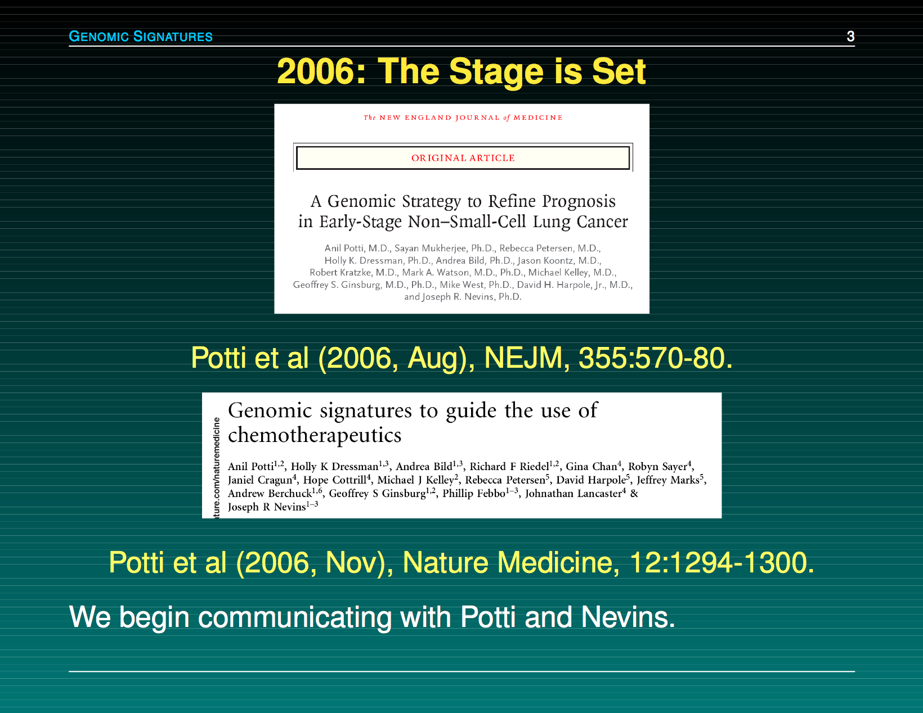
Slides by Keith Baggerly

Slide 8
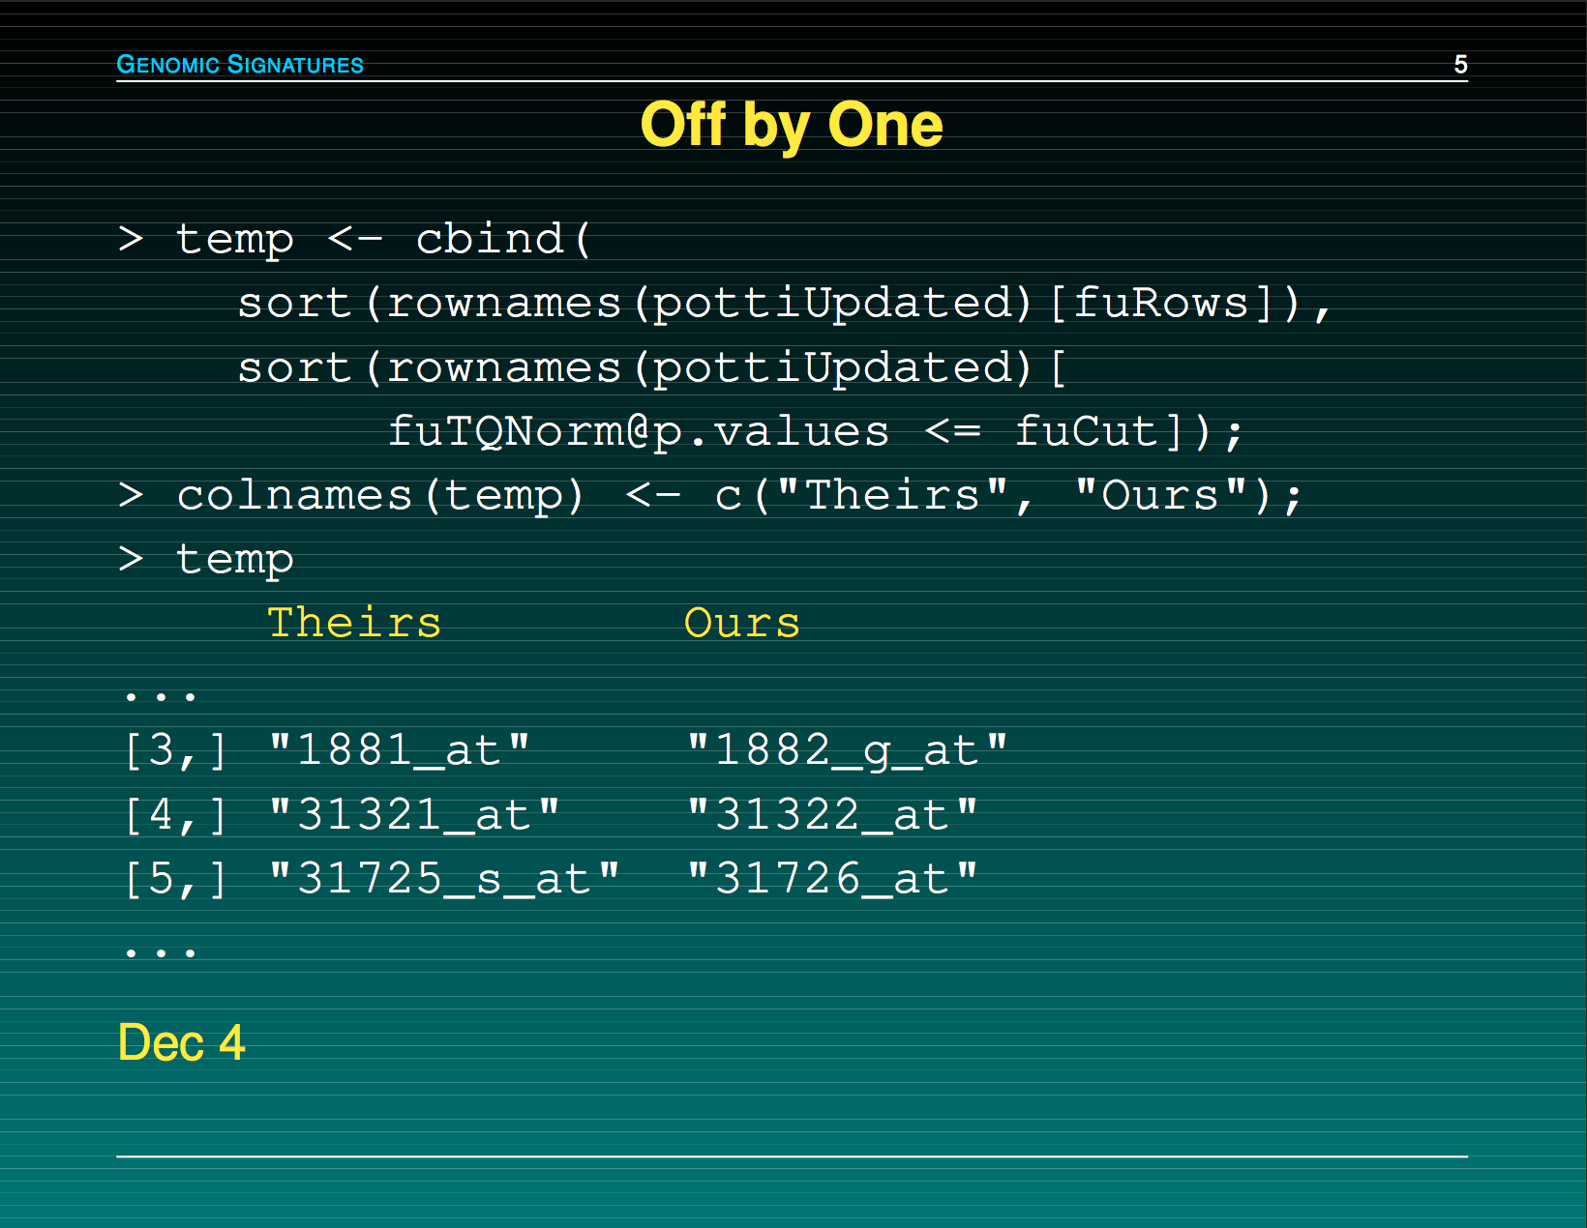
Slides by Keith Baggerly

Slide 9
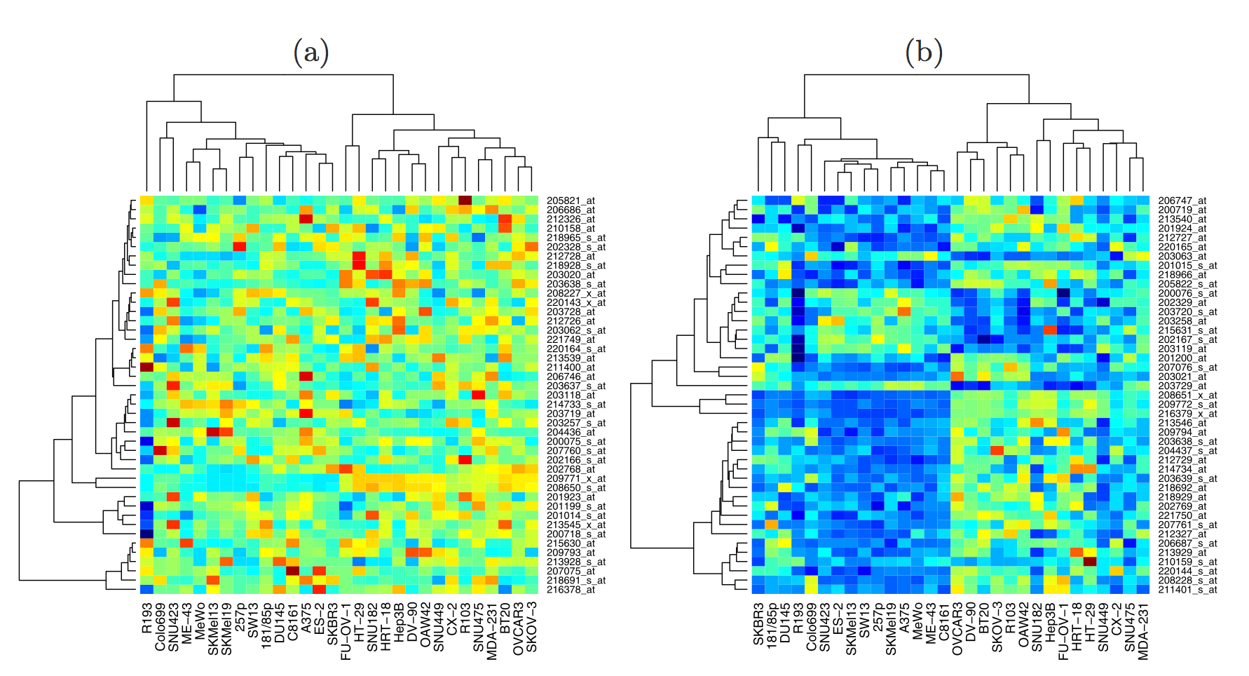
Slides by Keith Baggerly

Slide 10
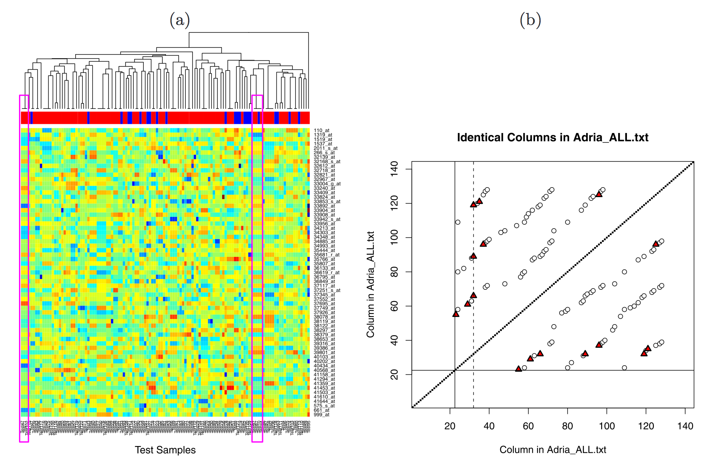
Baggerly & Coombes, AOAS 2009

Slide 11
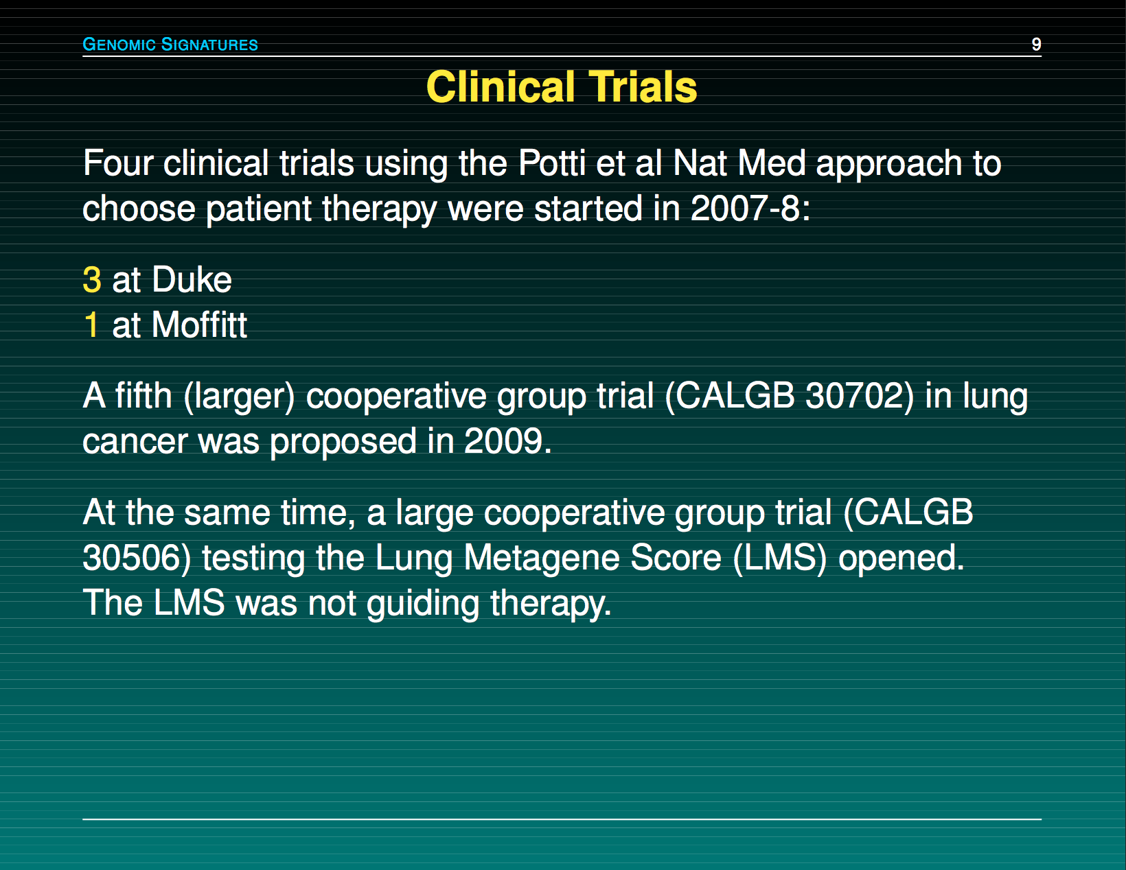
Slides by Keith Baggerly

Slide 12
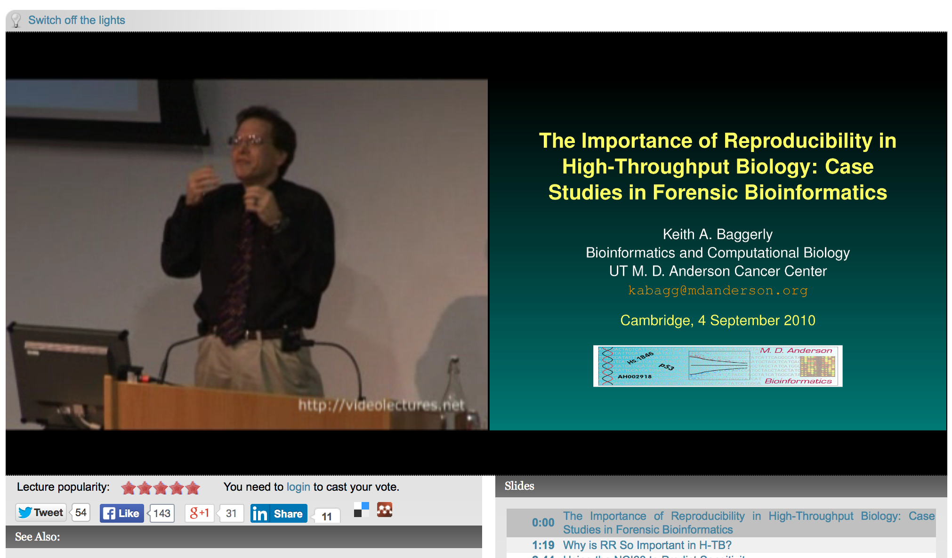
http://videolectures.net/cancerbioinformatics2010_baggerly_irrh/

Slide 13
Reproducible Research
0
It’s the right thing to do!
The world would be a better place if everyone did it!
It’s the foundation of Science!
It’s the honourable thing to do!

Slide 14
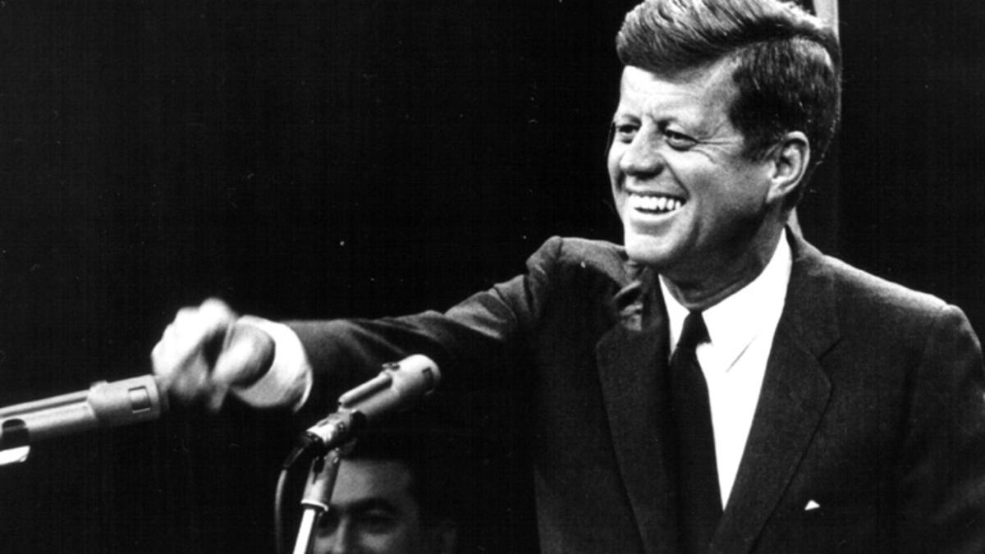
And so, my fellow scientists:
Ask not what you can do for reproducibility;
ask what reproducibility can do for you!

Slide 15
Reproducibility helps to avoid disaster
1

Slide 16
Anatomy of the NFκB pathway
Step 1
?
Hits
Weak
Phenotype
Strong
NFκB
Step 2
Knock-down
Compare
expression
phenotypes
by NEMs
Known pathway
members
New RNAi Hits

Slide 17
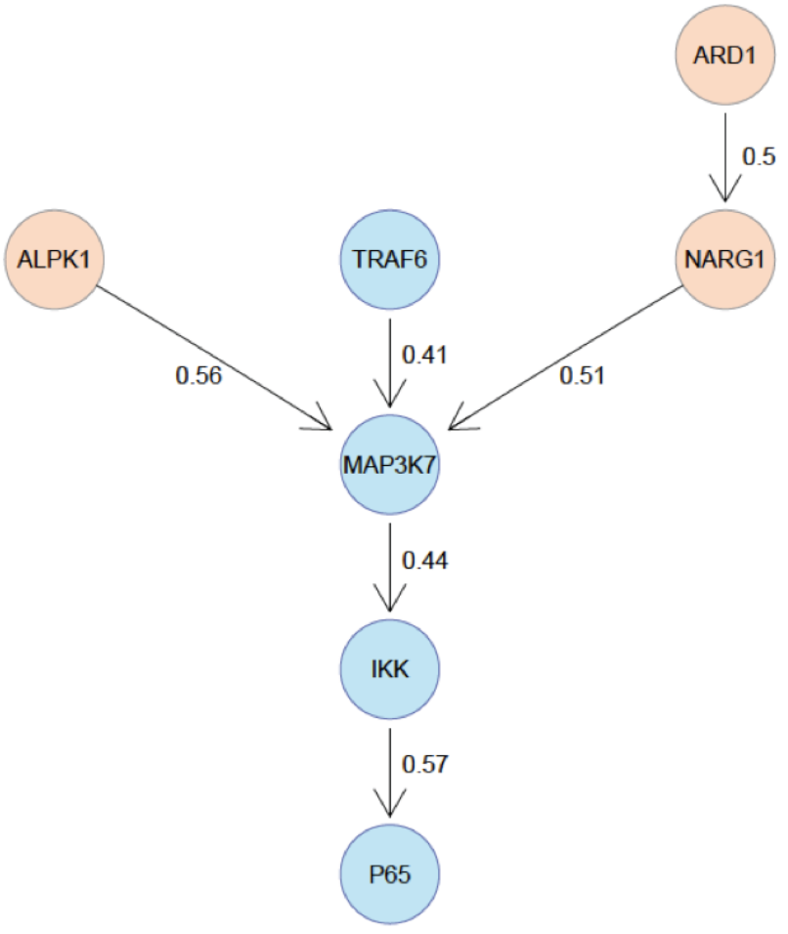
What a beautiful result!

Slide 18
What a beautiful result!
R.I.P.

Slide 19
A project is more
than a beautiful result!

Slide 20
Starting with
reproducibility early
helps saving time later

Slide 21
Reproducibility helps writing papers
2

Slide 22
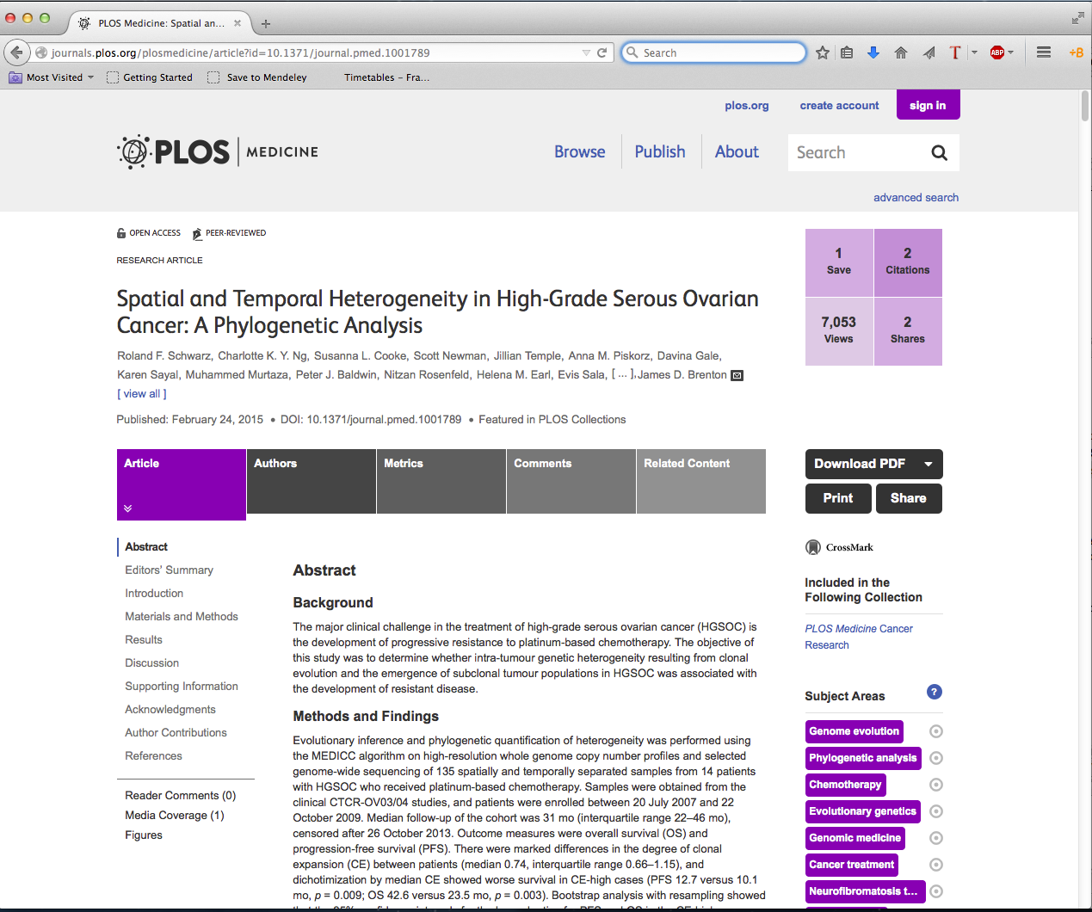

Slide 23
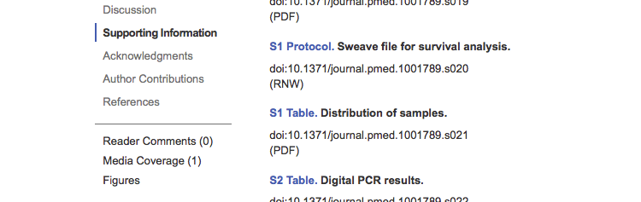

Slide 24
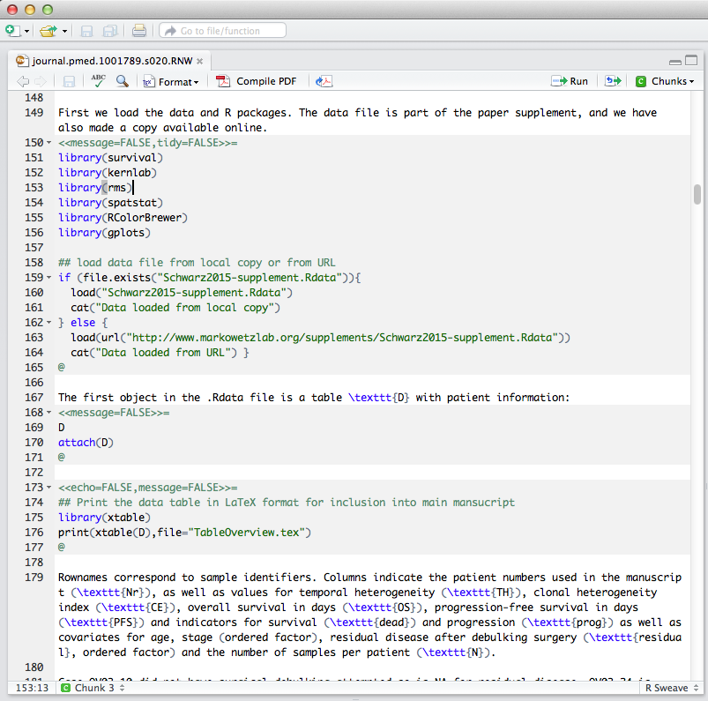

Slide 25
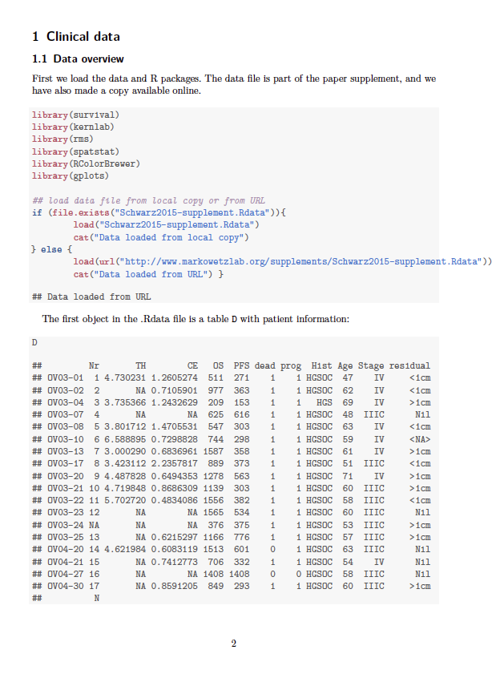

Slide 26
Why is well-documented and easily accessible code+data useful?
Easy to look up numbers and put them in manuscript
Be confident your figures and tables are up-to-date
Numbers and result automatically update when data change.
It is engaging and more eyes can look over the analysis.
Easier to spot mistakes.

Slide 27
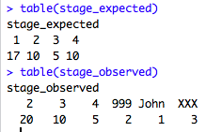
Why is well-documented and easily accessible code+data useful?
Easy to look up numbers and put them in manuscript
Be confident your figures and tables are up-to-date
Numbers and result automatically update when data change.
It is engaging and more eyes can look over the analysis.
Easier to spot mistakes.

Slide 28
Reproducibility helps reviewers see it your way
3

Slide 29
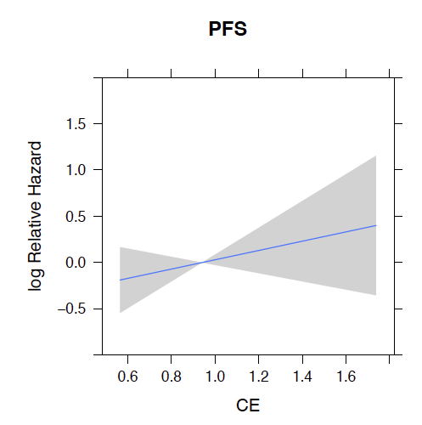
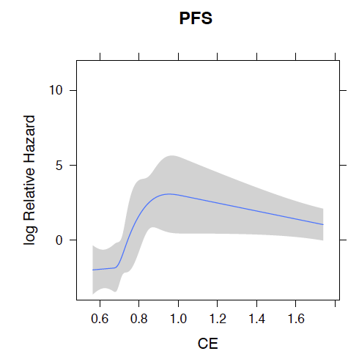
A very engaged reviewer
Reviewer: “I downloaded the authors’ data and tried out a variation of their analysis which gave an insignificant result”
We: “Thank you, the reason is XXX and if you do YYY everything is fine.”

Slide 30
Reproducibility enables continuity
4

Slide 31
“I am so busy,
I can’t remember all the details of all my projects”

Slide 32
“I’m sorry,
I did this analysis
6 months ago.”

Slide 33
“My PI said I should continue the project of a
previous postdoc.
But that postdoc is long gone and hasn’t saved
any scripts or data.”

Slide 34
Reproducibility helps to build your reputation
5

Slide 35
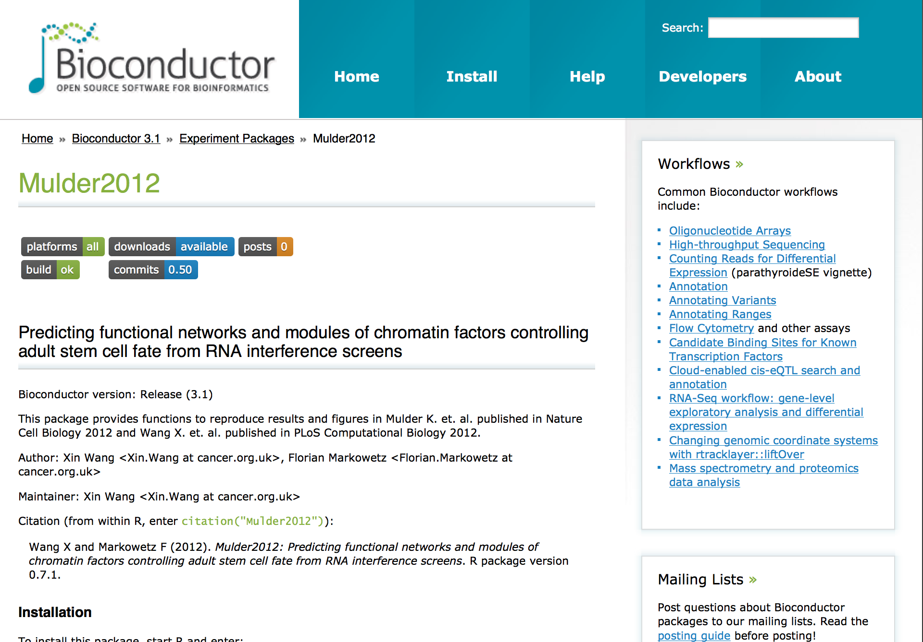

Slide 36
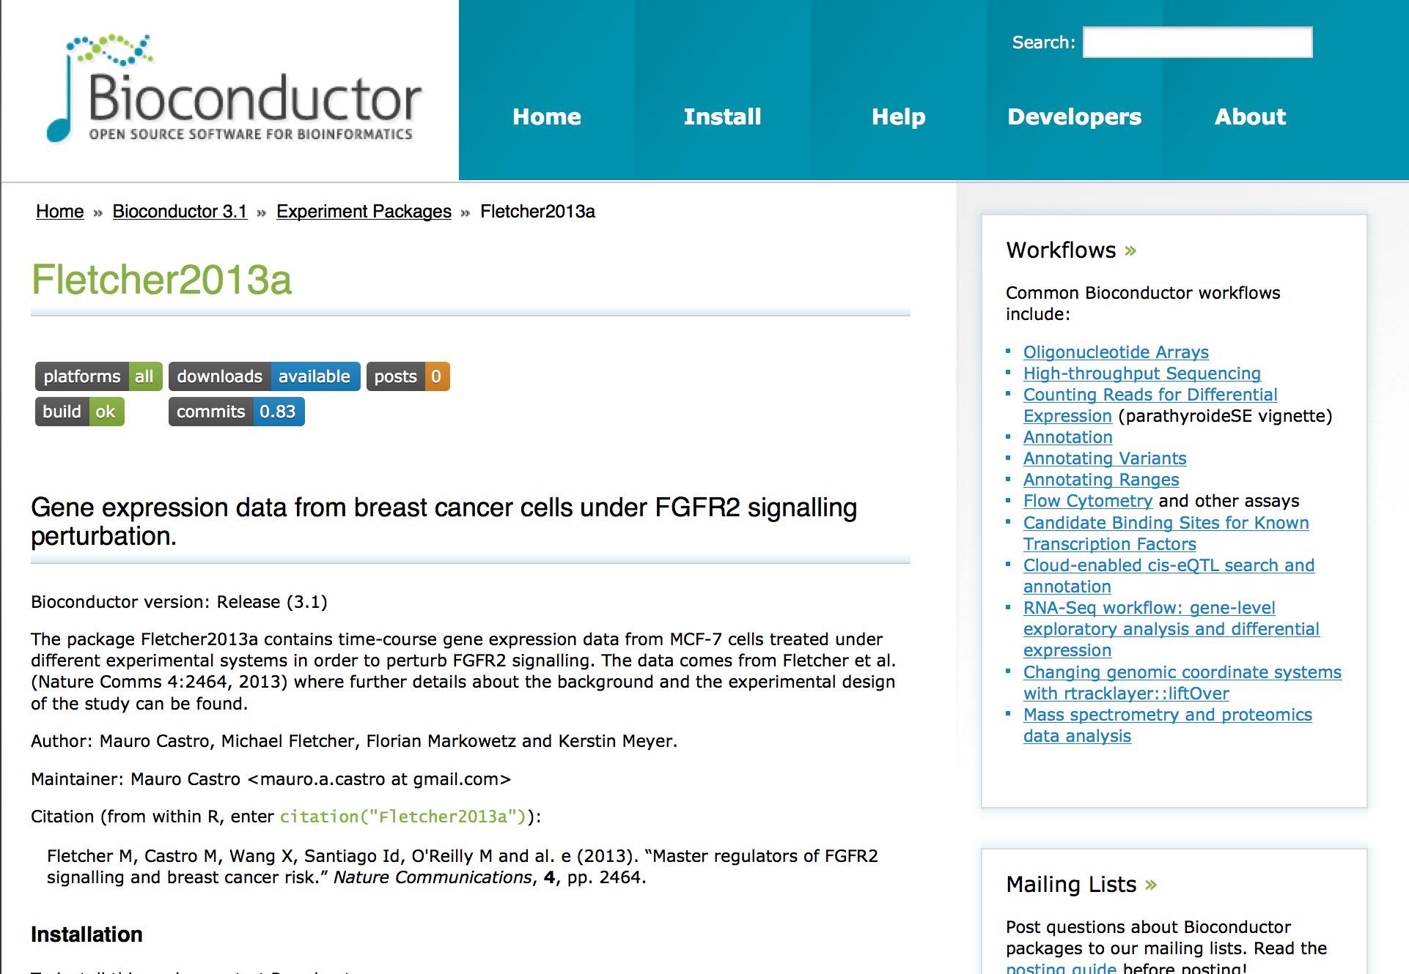

Slide 37
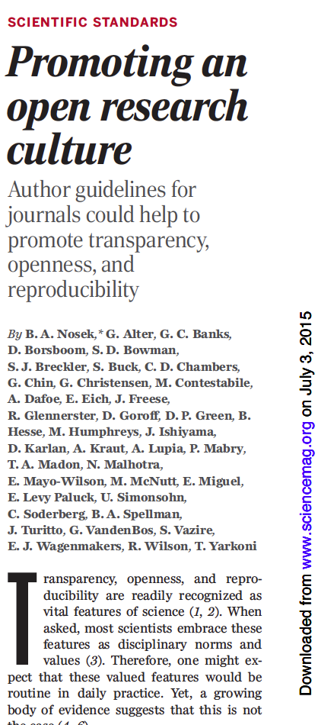
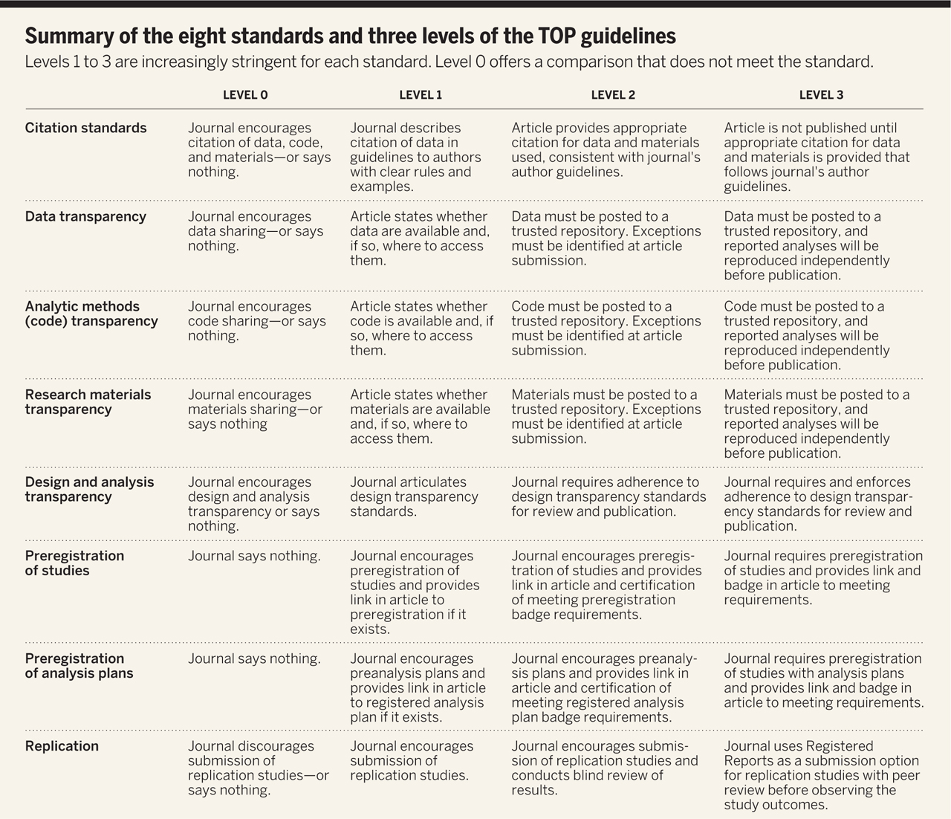

Slide 38


Slide 39
“It’s only the result that matters!”

Slide 40
“I’d rather do
real science
than tidy up
my data”

Slide 41
“Mind your own business!
I document my data the way I want!”

Slide 42
“Excel works just fine.
I don’t need any fancy R or Python or whatever.”

Slide 43
“Sounds alright, but my code and data are spread over so many hard drives and directories that it would just be too much work to collect them all in one place”

Slide 44
“We can always sort out the code and data
after submission”

Slide 45
“My field is very competitive
and I can’t risk wasting time”
Notes:
Think of it as putting in the right experimental controls. Can be time consuming but integral part of project.

Slide 46
Reproducibility is important for
Phd students
Postdocs
PIs
Learn tools and apply in daily work!
Create a ‘culture of reproducibility’ in your lab!

Slide 47
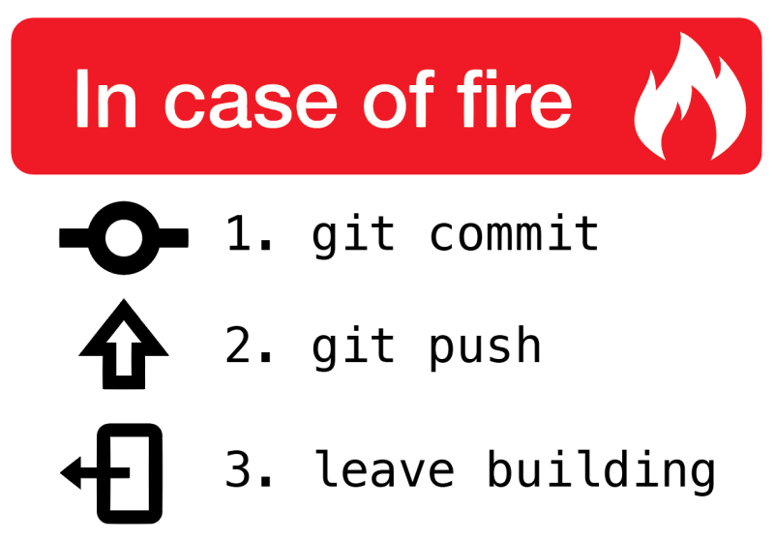

Slide 48
When do you need to worry about reproducibility?
Before you start the project
While you do the analysis
When you write the paper
When you co-author a paper
When you review a paper

Slide 49
When do you need to worry about reproducibility?
Before you start the project
While you do the analysis
When you write the paper
When you co-author a paper
When you review a paper
ALWAYS!

Slide 50
Scientific SOFT SKILLS
\project
\data
\code
\analysis
\paper
Organization of project
Tidy data
Tidy code
Control over tools
Documentation
Reproducibility
Less clicking and pasting,
more scripting and coding

Slide 52
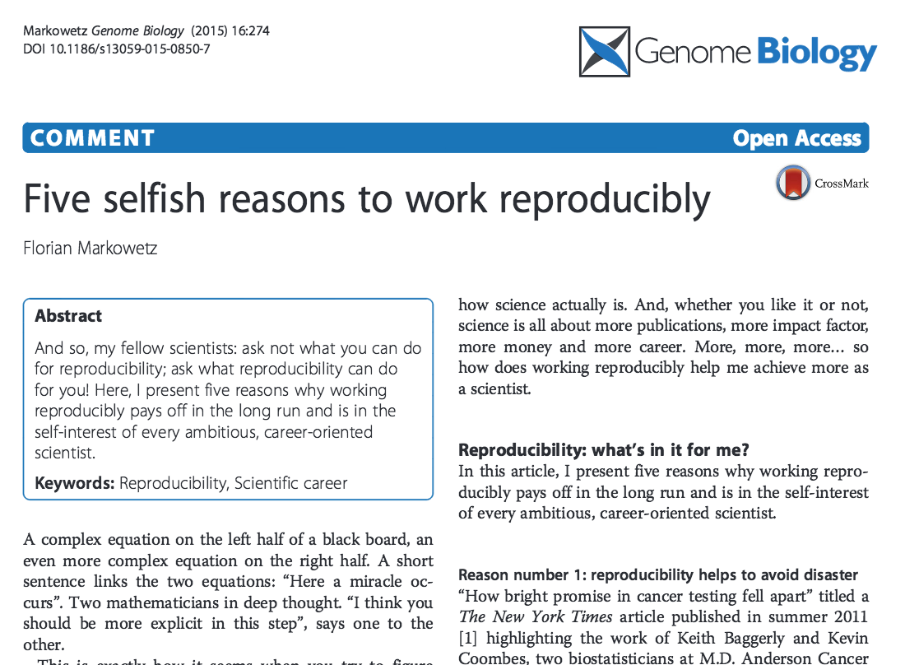

Slide 53
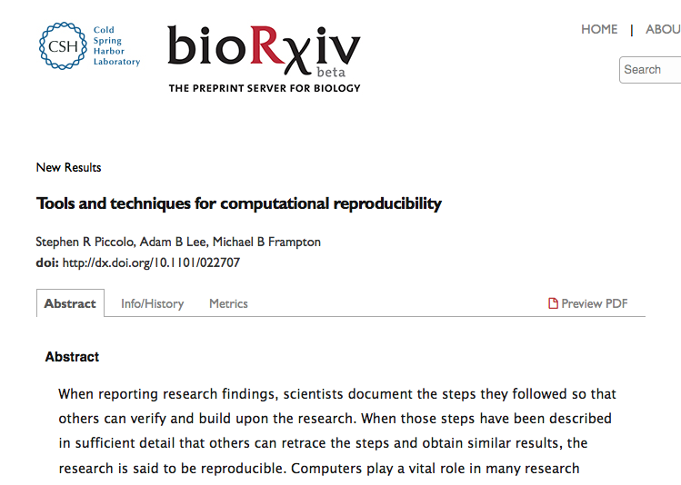

Slide 54
5 selfish reasons to work reproducibly
Avoid disaster
Easier to write papers
Easier to talk to reviewers
Continuity of your work/in the lab
Reputation

Slide 55
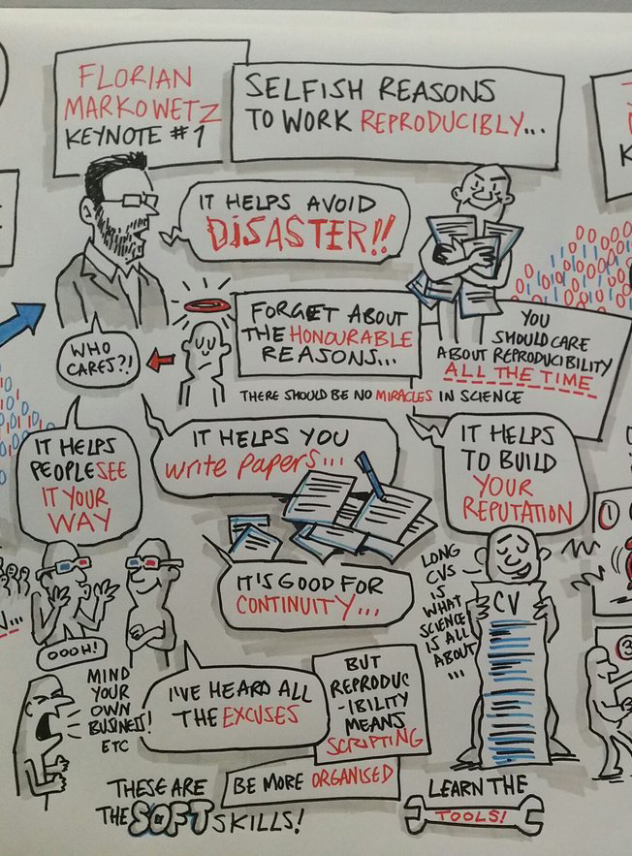
Publishing Better Science
through Better Data 2016
(#scidata16)
Cartoon by
Royston Robertson
www.roystoncartoons.com/

